Slide 1
Bell Work (8–12 minutes to work on own or in small groups before going over answer)
If we want to build a track that is 200 meters around, but you also want to maximize the area of the rectangle. What dimensions of x and y will do that? What is the max area?
Hint: How do you find area of a rectangle? Can you write an equation that you’d graph to find the maximum?
X
Y

Slide 2
Bell Work Answer (12– 15 minutes to analyze answer) (Work together to understand where the answers came from… we’ll discuss when I return)
If we want to build a track that is 200 meters, but also want to maximize the area of the rectangle. What dimensions of x and y will do that? What is the max area?
X
Lets talk about Perimeter first:
Perimeter = 200 (given to us)
So that means that the 2 curves, plus the 2 ‘x’ sides of the track must equal 200
We need to add up those distances…
200 = x+x + 2(y/2) (plug in)
200 = 2x + y (simplify)
y = (200 – 2x)/  (solve for y)
Y
Note: If you push the ends together it makes a circle with a diameter of y… Therefore the radius is y/2… we can find the circumference (C = 2r) by plugging in r = y/2, and add it to the two sides of x
So…. NOW we can maximize the area & find dimensions!

Slide 3
If we want to build a track that is 200 meters, but also want to maximize the area of the rectangle. What dimensions of x and y will do that? What is the max area?
Now we can find the max area:
Area of rectangle = x y
A = x ((200 – 2x)/ )
Graph the area formula above in your calculator (think of A – output -- as the y and x is the input so it is still x).
Max: located at (50, 100/)
Dimensions: x = 50 by y = 100/
Area of rectangle = x y → (50)(100/ )
Max Area = 1591.549
Max Area = 1591.549
Y=
100/
X=
50
Remember from previous slide
we found what y equals.
y = (200 – 2x)/ 

Slide 4
From Last Time… (finish 5 – 15 minutes) depending on how class went last time
Page 132 #7-12, 21-27 (odd), 76, 77, 81

Slide 5
Pre-calc trig
Day 14

Slide 6
2.2 Polynomial Functions of Higher Degree
Objective: To become familiar with the features of polynomial graphs of higher degree
HLQ: As you increase the degree of a polynomial, what impact does this have on the graph (curves?, x-intercepts?, end behavior?, etc…)?

Slide 7
Important Concepts (less important with graphing calculator)
Polynomial functions are continuous graphs
[they don’t stop or break]
Polynomial functions are have smooth curves
[there aren’t corners, points, etc.]
Number of solutions = Same as the Degree
Number of turning points = Degree - 1

Slide 8
Leading Coefficient Test: Determines End Behavior [Not as important since we have calculators! End behavior is just… which direction is graph pointing at its ends]
Even Degree → Both ends point up (if lead coefficient is positive)
→ Both ends point down (if lead coefficient is negative)
Odd Degree → Right side points up and left side points down (if lead coefficient positive)
→ Right side points down and left sides point up (if lead coefficient negative)

Slide 9
More about Real Zeros (we can go over this more next time if needed)
x = a is a zero of function
x = a is a solution of polynomial f(x) = 0
(x – a) is a factor of polynomial f(x)
(a , 0) is an x-intercept of the graph of f
Repeated zeros when graph touches, but does not cross

Slide 10

State the degree and # of turning points, describe the end behavior, find all real zeros, and sketch a graph
1.) $y=x^{4}−5x^{2}+4$

Slide 11
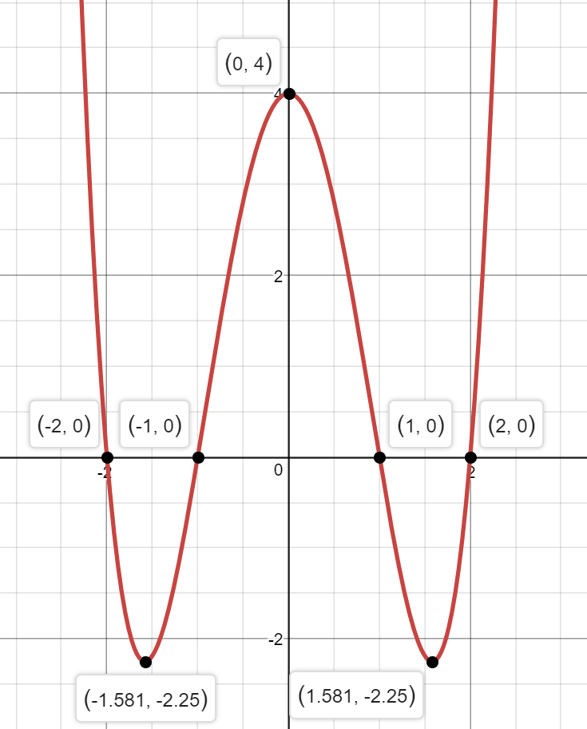
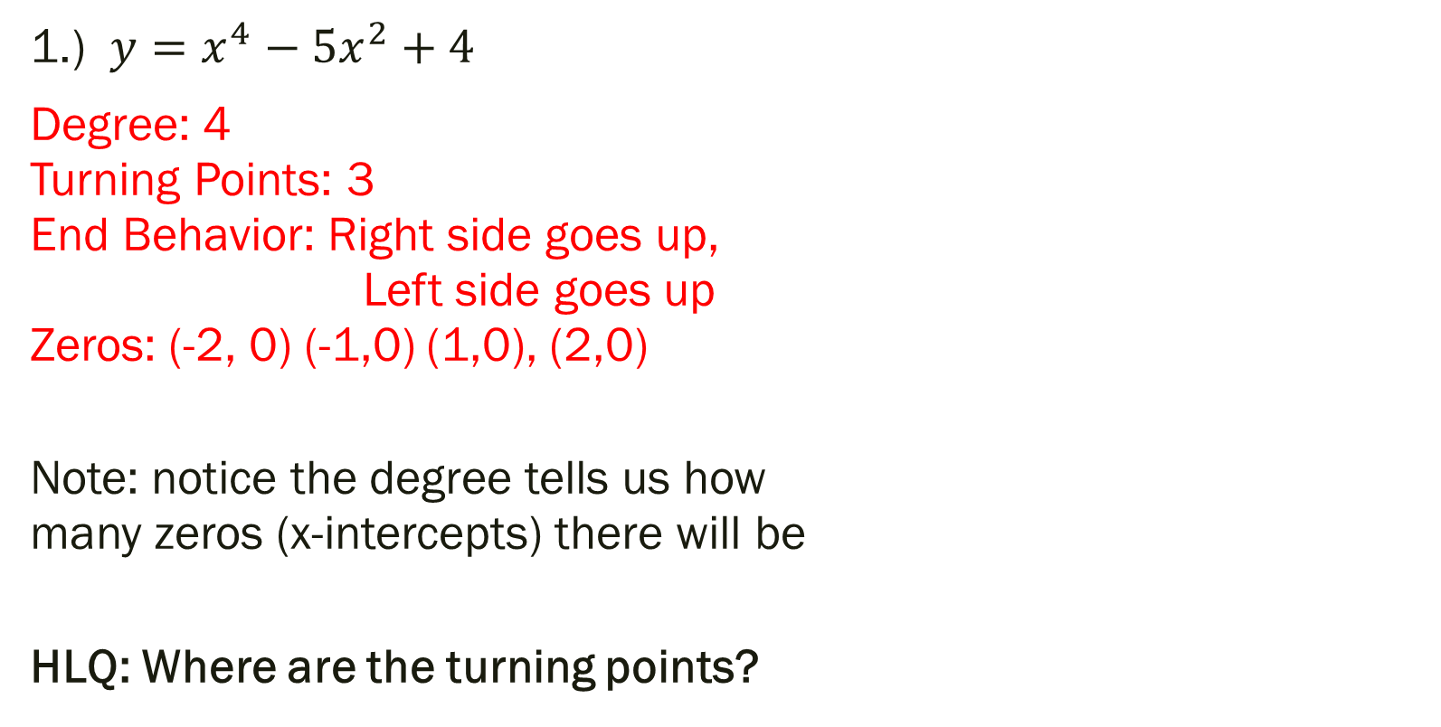
State the degree and # of turning points, describe the end behavior, find all real zeros, and sketch a graph
1.) $y=x^{4}−5x^{2}+4$
Degree: 4 Turning Points: 3 End Behavior: Right side goes up, Left side goes up Zeros: (-2, 0) (-1,0) (1,0), (2,0)
Note: notice the degree tells us how many zeros (x-intercepts) there will be
HLQ: Where are the turning points?

Slide 12
For next time…
Page 146 #25, 29, 43, 47, 57, 97
If you finish this assignment, and your previous assignment, please find something to work on quietly, and we’ll tie up any loose ends next time when I return. You are all awesome!

